Slide 1
RecoverEase: The Lost Item Solution using Deep Image Search
Team Details
Kothuri Naga Chandhana (20EG105229)
Maddi Siddharth Reddy (20EG105232)
Janga Monika (20EG105258)
Project Supervisor
Mr. V Amarnadh,
Assistant Professor

Slide 2
Introduction
What it is:-
RecoverEase is an advanced lost and found system that leverages a multidimensional matching model based on deep image search technology.
Unlike traditional methods that rely primarily on textual descriptions, this system uses sophisticated image recognition algorithms to identify lost items, significantly enhancing accuracy and efficiency in the matching process.

Slide 3
Introduction
What is needed:-
For RecoverEase to operate effectively, the following components are essential:
Image Database: A comprehensive database containing images of both lost and found items. This database needs to be regularly updated with new entries as users report lost or found items.
Deep Learning Model: A robust deep learning model capable of extracting features from images and performing accurate matching based on those features. This model should be trained on a diverse dataset to ensure versatility and effectiveness across different types of items.
User Interface: An intuitive user interface through which users can report lost items by uploading images and provide additional details such as time and location of loss.

Slide 4
Applications:-
Transportation Hubs
Tourist Attractions
Shopping Centers
Events and Conferences
Corporate Environments

Slide 5
Problem Statement
Traditional lost and found systems often struggle with accurately matching lost items with their owners due to the limitations of relying solely on textual descriptions. These limitations include inaccuracies in descriptions, subjective interpretation of text, difficulties in describing unique or sentimental items, and inefficiencies in the matching and retrieval process. As a result, users may experience frustration when attempting to reclaim lost items, and the system may become burdened with unclaimed items, leading to increased storage requirements and administrative overhead.

Slide 6
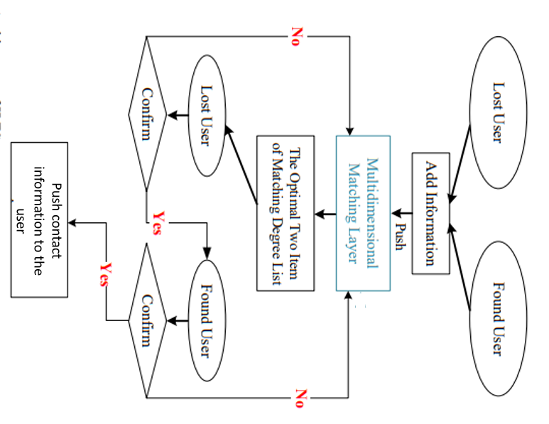
Proposed Method:Architecture of ILFS

Slide 7
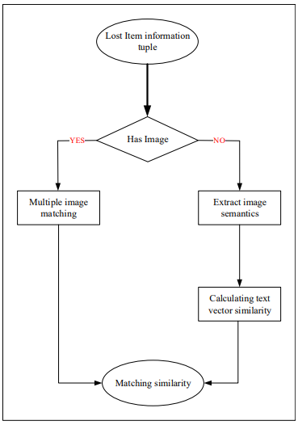
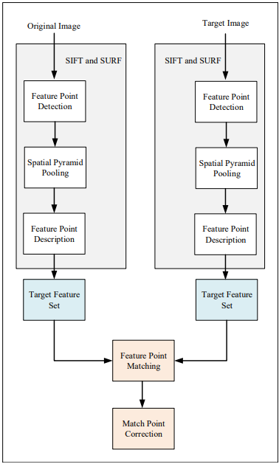
Multidimensional Matching Layer

Slide 8
Deep Image Search Algorithm
1.Dataset Preparation: Collect a dataset of images containing both lost and found items reported on the website.
2.Neural Network Training and feature extraction: Choose a pre-trained SIFT (Scale-Invariant Feature Transform) and SURF (Speeded-Up Robust Features) suitable for image feature extraction
3.Indexing: Create an index data structure (e.g., a database or search index) to store the feature vectors and metadata of all images. Organize the index to facilitate efficient search operations, such as using KD-trees or inverted indexing.
4.Querying: When a user uploads an image of a lost item to the website, extract the feature vector for the query image using the same CNN used during training. Search the index to find images of found items with feature vectors that are close to the feature vector of the query image.

Slide 9
Deep Image Search Algorithm
5. Retrieval: Rank the retrieved images based on their similarity scores to the query image, with more visually similar images ranked higher. Retrieve the top-k most visually similar images of found items to the query image, where k is a predefined parameter.
6. User Interaction: Enable the user to interact with the search results, providing notification and refining their search criteria based on the retrieved images. Allow the user to contact the owner of a found item if they believe it matches their lost item.

Slide 10
Experiment Environment
Framework : Django 3.2
Database : PostgreSQL
Deep Learning Framework : PyTorch
Web Server : Apache
Email Service : SMTP

Slide 11
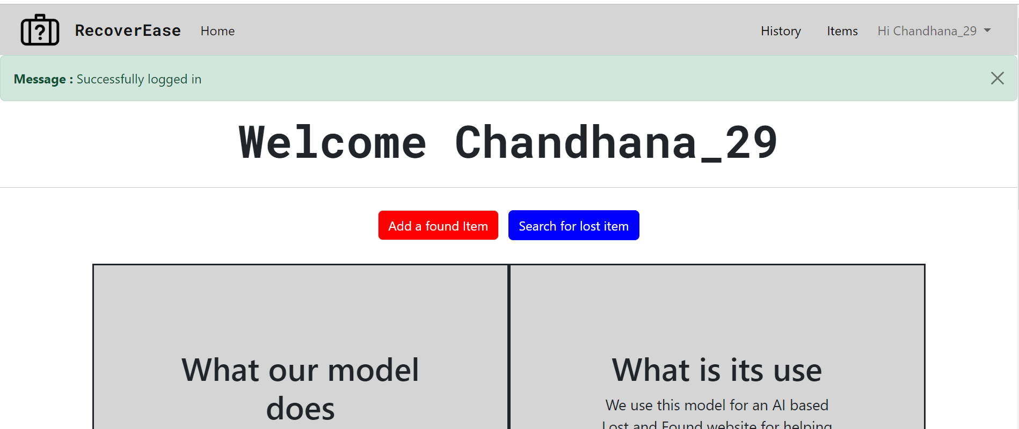
Experiment Screen shorts

Slide 12
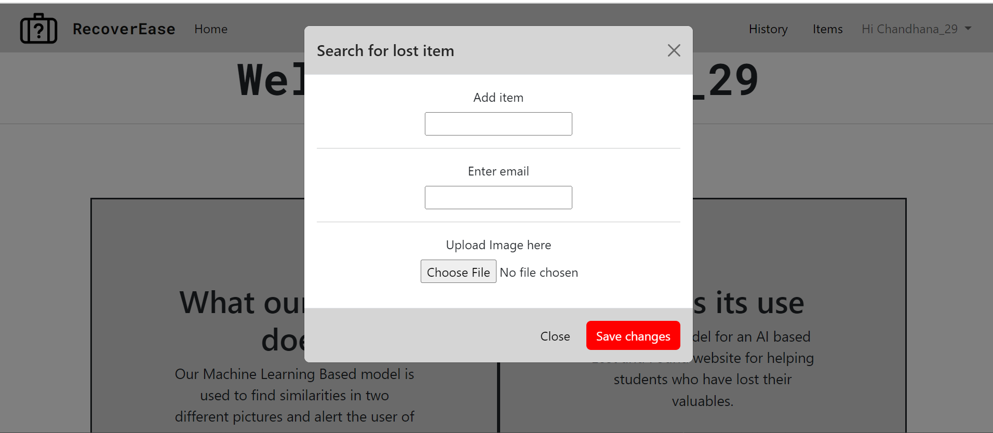
Experiment Screen shorts

Slide 13
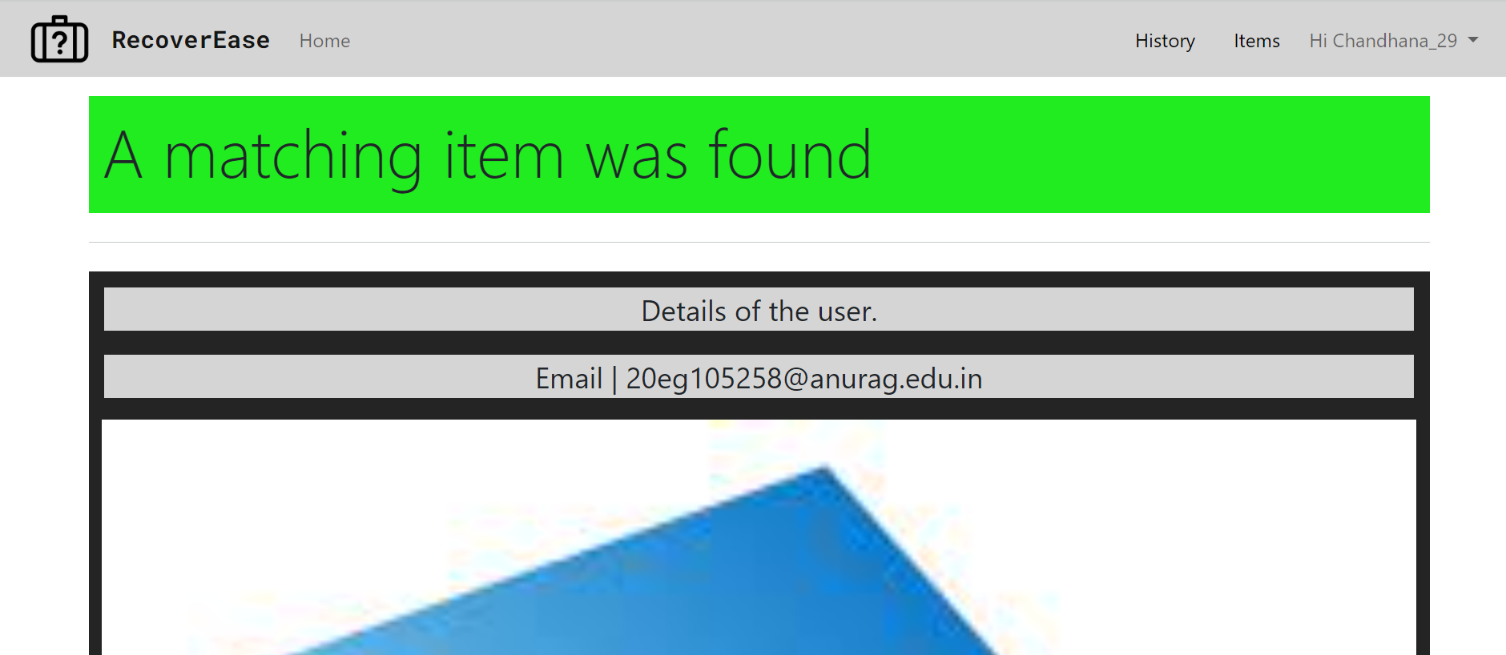
Experiment Screen shorts

Slide 14
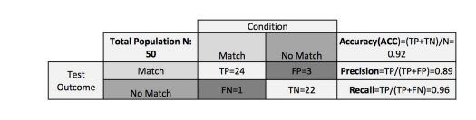
Experiment Results

Slide 15
Justification
1.What are parameters improved by your method
Accuracy
Robustness
User Experience
Handling Multimodal Data
2. Mathametic formulas for calculating parameter values
Accuracy = (Number of correctly matched items) / (Total number of items)
Robustness = (Number of accurate matches under varying conditions) / (Total number of matches)
Multimodal Handling = 1

Slide 16
THANK YOU

